Slide 1
Essentials of Machine Learning Algorithms

Slide 2
List of Common Machine Learning Algorithms
Here is the list of commonly used machine learning algorithms. These algorithms can be applied to almost any data problem:
Linear Regression
Logistic Regression
Decision Tree
SVM
Naive Bayes
kNN
K-Means
Random Forest

Slide 3
Linear Regression
This best fit line is known as regression line and represented by a linear equation Y= a *X + b.
In this equation:
Y – Dependent Variable
a – Slope
X – Independent variable
b – Intercept

Slide 4
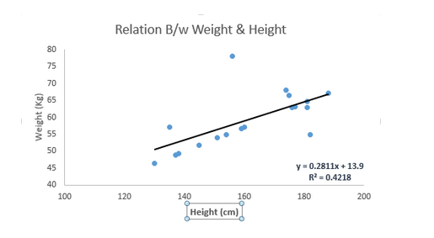
These coefficients a and b are derived based on minimizing the sum of squared difference of distance between data points and regression line.
The best fit line having linear equation y=0.2811x+13.9. Now using this equation, we can find the weight, knowing the height of a person.

Slide 5
Logistic Regression
It is a classification not a regression algorithm. It is used to estimate discrete values ( Binary values like 0/1, yes/no, true/false ) based on given set of independent variable(s).
In simple words, it predicts the probability of occurrence of an event by fitting data to a logit function
Mathematical Equation:
odds= p/ (1-p) = probability of event occurrence / probability of not event occurrence
ln(odds) = ln(p/(1-p))
logit(p) = ln(p/(1-p)) = b0+b1X1+b2X2+b3X3....+bkXk
Notes:
Let’s say your friend gives you a puzzle to solve. There are only 2 outcome scenarios – either you solve it or you don’t. Now imagine, that you are being given wide range of puzzles / quizzes in an attempt to understand which subjects you are good at. The outcome to this study would be something like this – if you are given a trignometry based tenth grade problem, you are 70% likely to solve it. On the other hand, if it is grade fifth history question, the probability of getting an answer is only 30%. This is what Logistic Regression provides you.

Slide 6
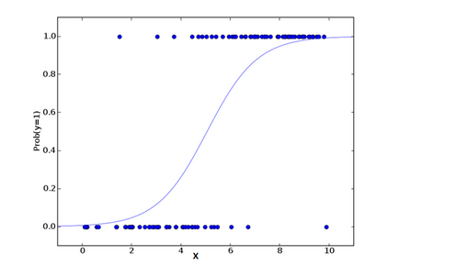

Slide 7
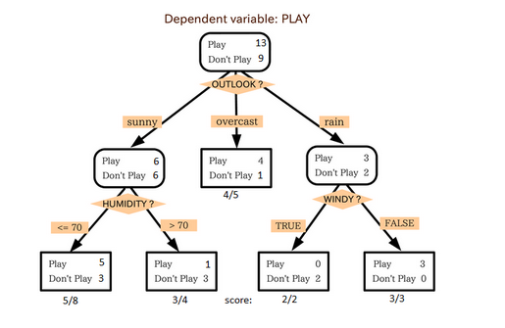
Decision Tree(Gini, Information Gain, Chi-square, entropy.)

Slide 8
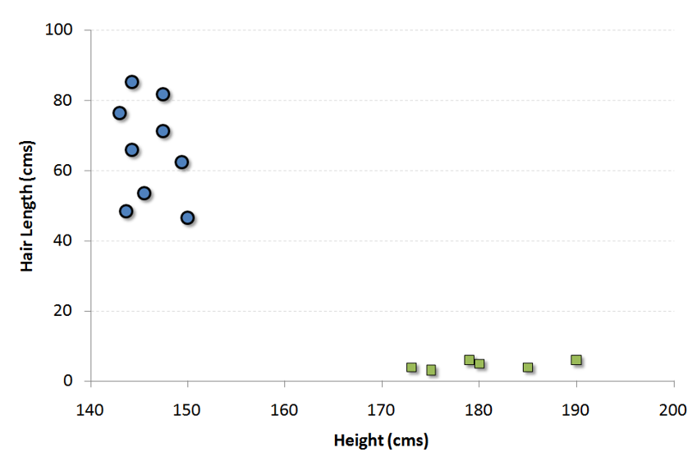
SVM (Support Vector Machine)
Notes:
For example, if we only had two features like Height and Hair length of an individual, we’d first plot these two variables in two dimensional space where each point has two co-ordinates (these co-ordinates are known as Support Vectors)

Slide 9
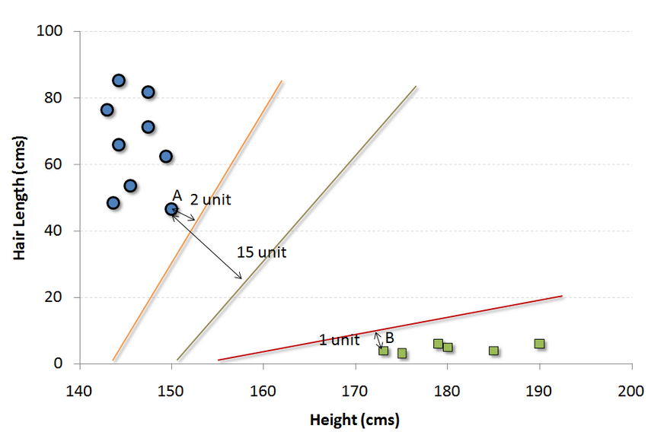

Slide 10
Naive Bayes
It is a classification technique based on Bayes’ theorem with an assumption of independence between predictors. In simple terms, a Naive Bayes classifier assumes that the presence of a particular feature in a class is unrelated to the presence of any other feature.
Notes:
For example, a fruit may be considered to be an apple if it is red, round, and about 3 inches in diameter. Even if these features depend on each other or upon the existence of the other features, a naive Bayes classifier would consider all of these properties to independently contribute to the probability that this fruit is an apple.

Slide 11
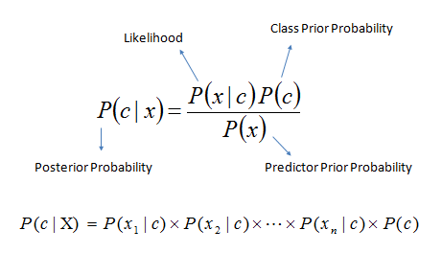
Example
Here,
P(c|x) is the posterior probability of class (target) given predictor (attribute).
P(c) is the prior probability of class.
P(x|c) is the likelihood which is the probability of predictor given class.
P(x) is the prior probability of predictor.

Slide 12
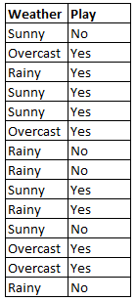
Example

Slide 13
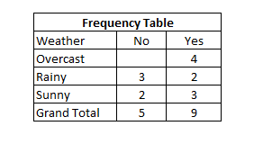
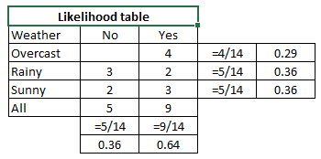

Slide 14
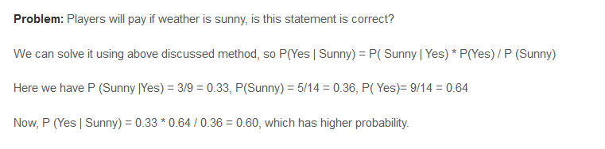

Slide 15
kNN (k- Nearest Neighbors)
it is more widely used in classification problems in the industry. K nearest neighbors is a simple algorithm that stores all available cases and classifies new cases by a majority vote of its k neighbors. The case being assigned to the class is most common amongst its K nearest neighbors measured by a distance function.

Slide 16
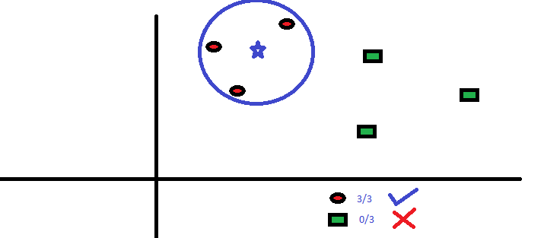
Example
Notes:
If you want to learn about a person, of whom you have no information, you might like to find out about his close friends and the circles he moves in and gain access to his/her information!

Slide 17
Random Forest
Random Forest is a trademark term for an ensemble of decision trees. In Random Forest, we’ve collection of decision trees (so known as “Forest”). To classify a new object based on attributes, each tree gives a classification and we say the tree “votes” for that class. The forest chooses the classification having the most votes (over all the trees in the forest).
Notes:
Human race is at war with an alien species called “Mimics”. Mimic is described as a far more evolved civilization of an alien species. Entire Mimic civilization is like a single complete organism. It has a central brain called “Omega” which commands all other organisms in the civilization. It stays in contact with all other species of the civilization every single second. “Alpha” is the main warrior species (like the nervous system) of this civilization and takes command from “Omega”. “Omega” has the power to reset the day at any point of time.
Now, let’s wear the hat of a predictive analyst to analyze this plot. If a system has the ability to reset the day at any point of time, it will use this power, whenever any of its warrior species die. And, hence there will be no single war ,when any of the warrior species (alpha) will actually die, and the brain “Omega” will repeatedly test the best case scenario to maximize the death of human race and put a constraint on number of deaths of alpha (warrior species) to be zero every single day. You can imagine this as “THE BEST” predictive algorithm ever made. It is literally impossible to defeat such an algorithm.

